Slide 1


Instacart A System Redesign
Prepared By:
Aarushi
Alice
Ravijot
Saajan
Shreya

Slide 2

About the company

Slide 3
About the company
It is a same-day grocery delivery service
Established in year 2012
HQ in San Francisco
Operates in selected cities of US and Canada
Partnership with Whole Foods Market, Petco, Costco, Loblaw Companies, Real Canadian Superstore, T & T Supermarket

Slide 4
About the company
Service provided by website and smartphone app for Android and iOS
User defined delivery time process
Supports Google Wallet

Slide 5
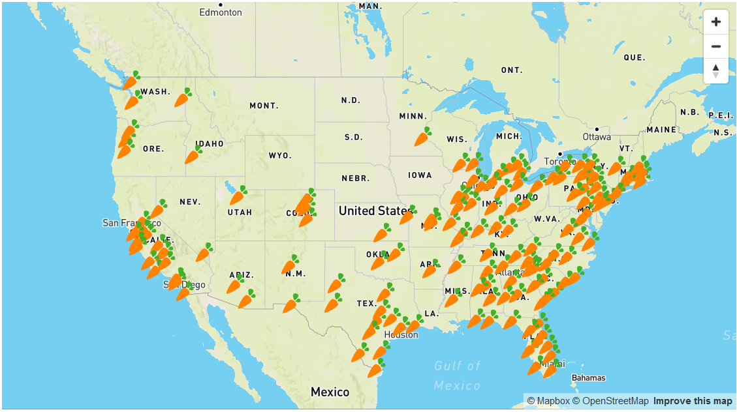
Operates In Various Cities Across U.S.A.

Slide 6
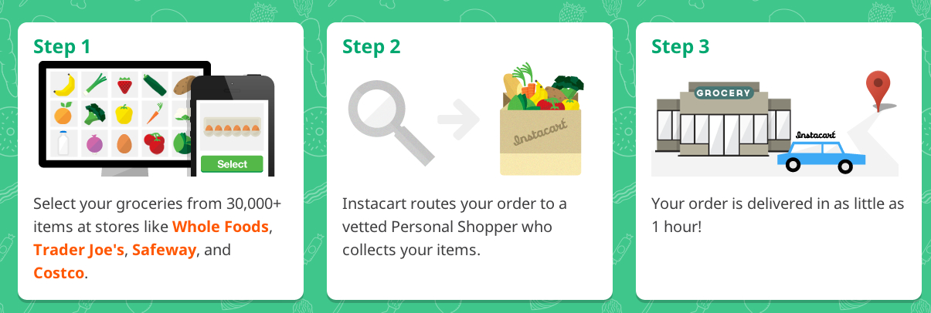
How Instacart works?

Slide 7
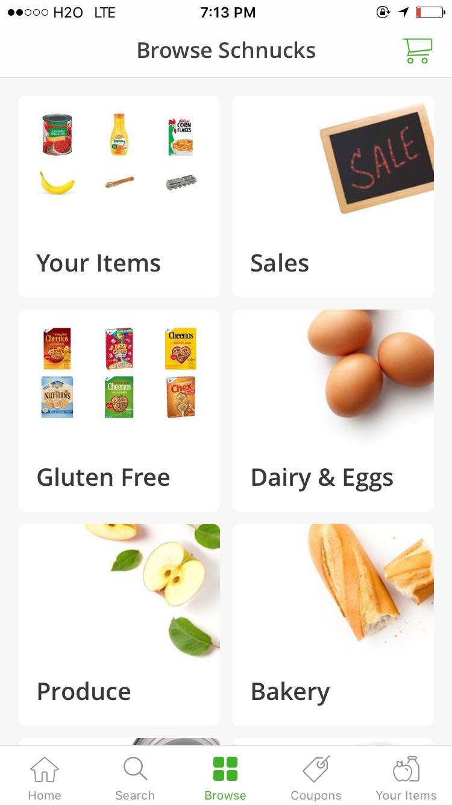
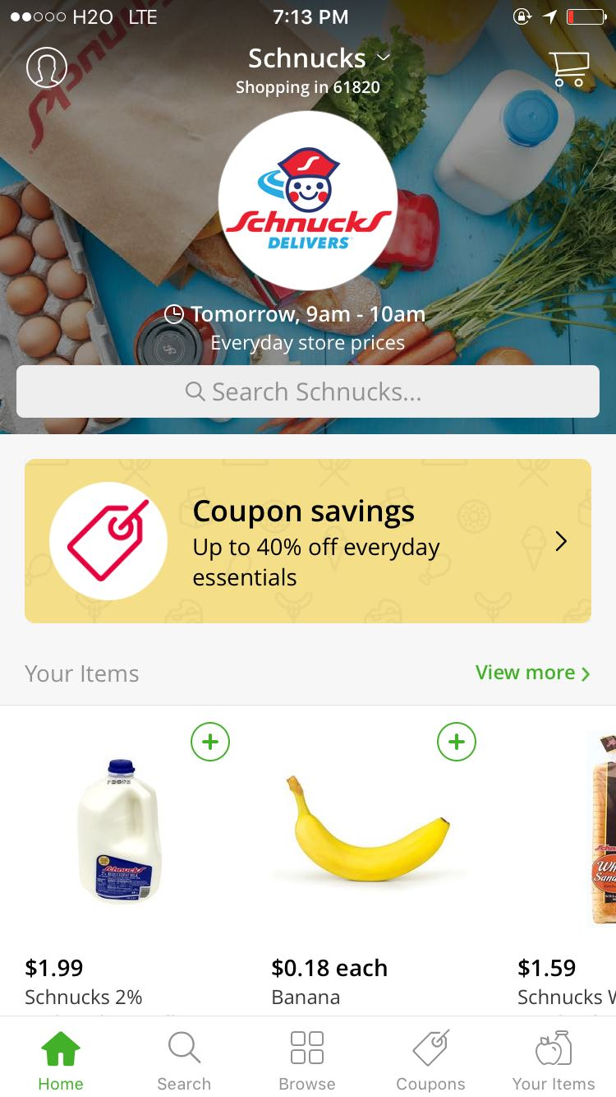
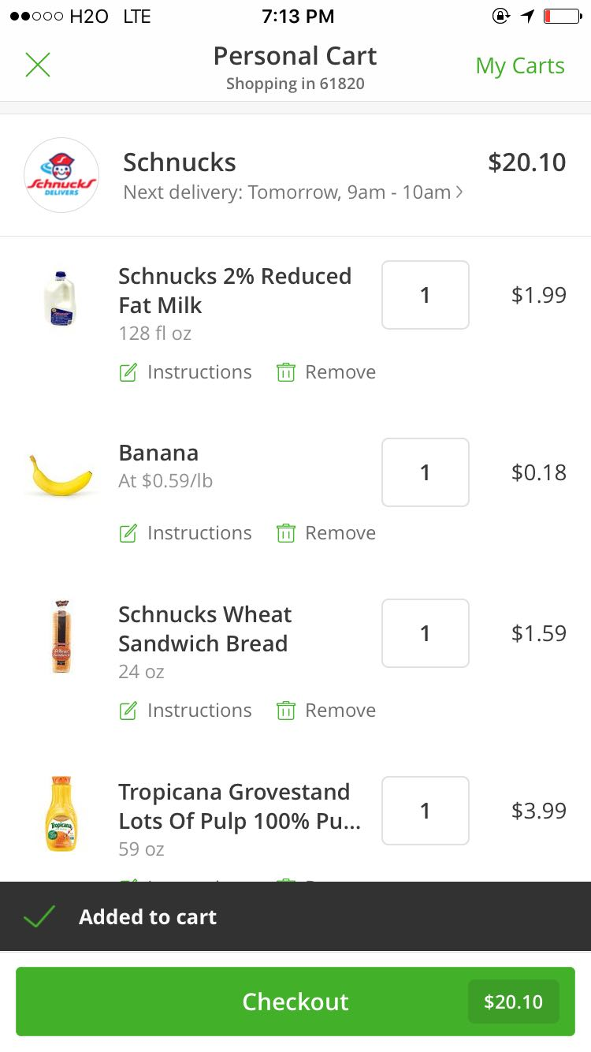
Instacart App

Slide 8
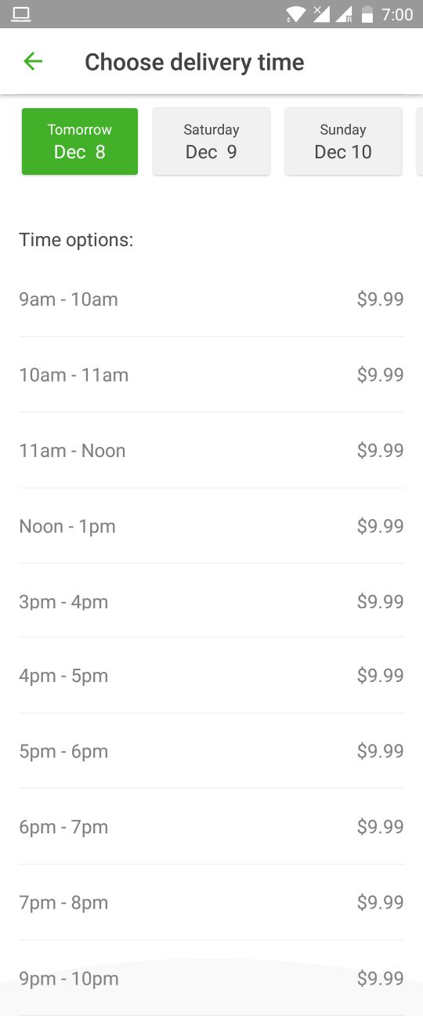
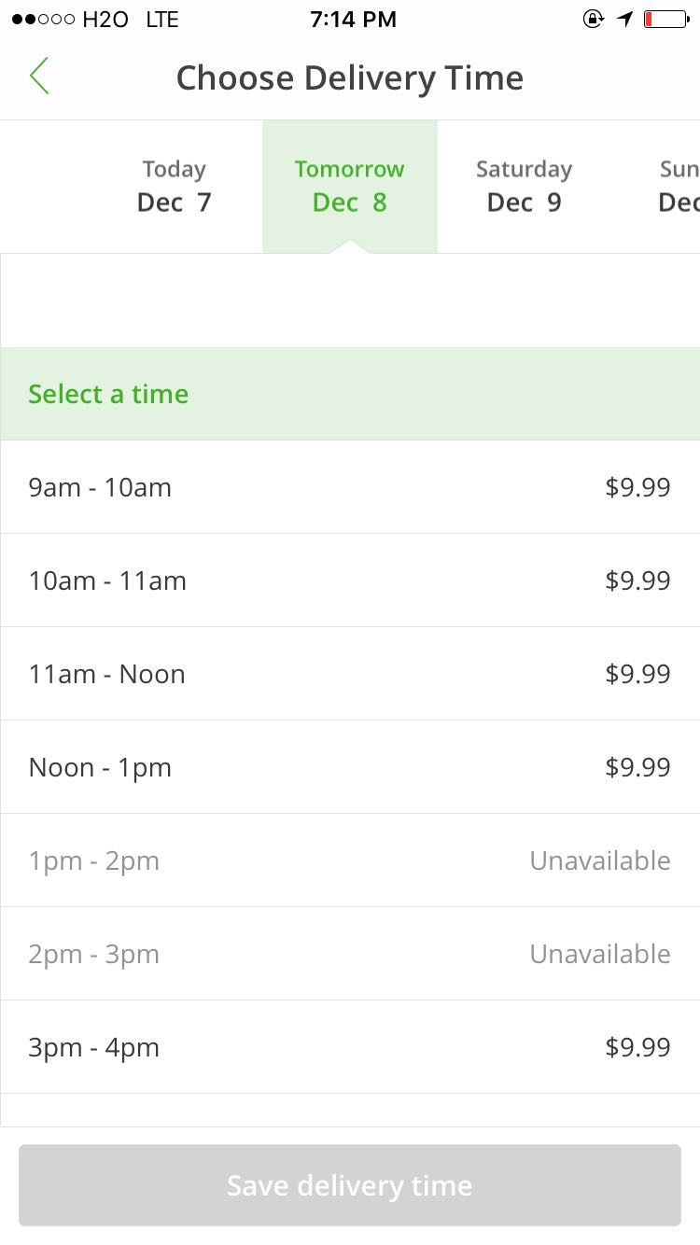
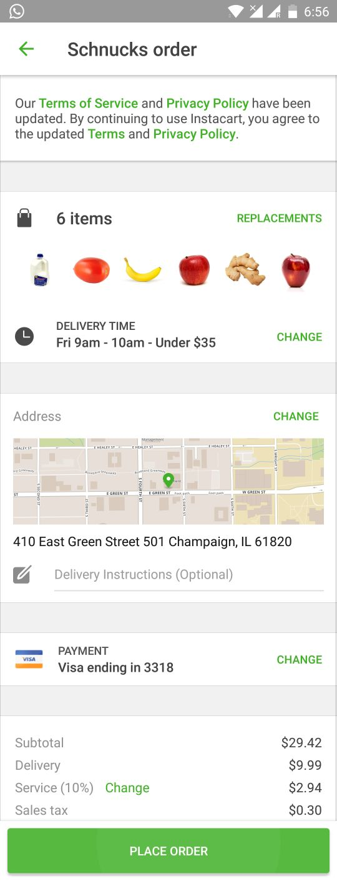
Instacart App

Slide 9
System Participants

Slide 10
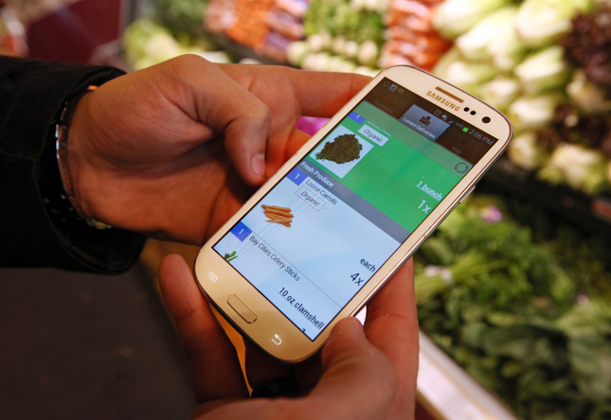

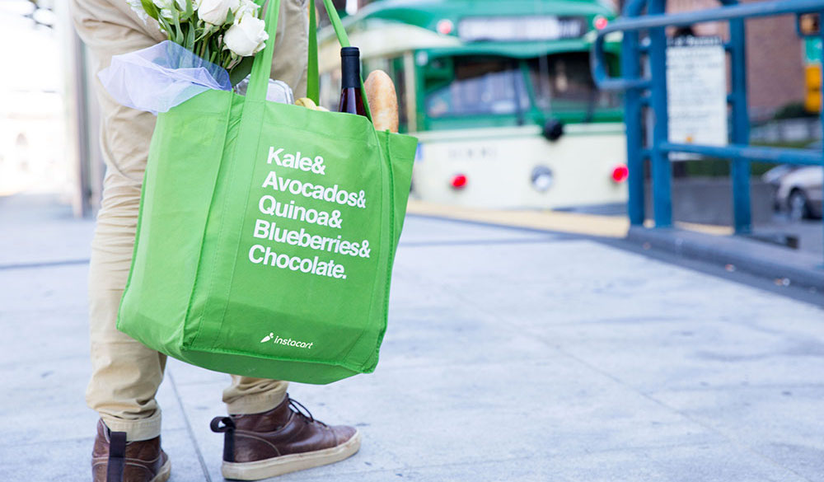
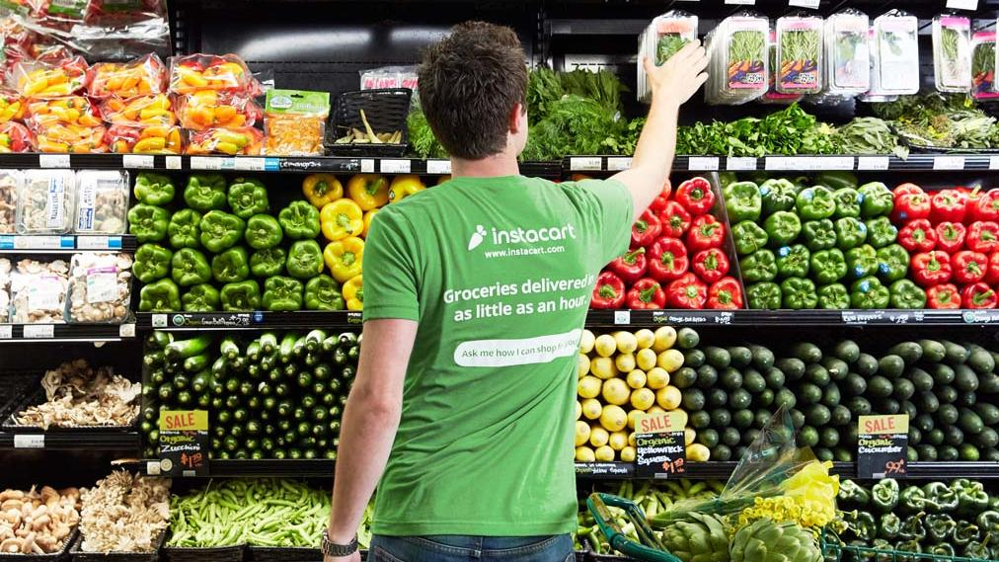
System Participants
Social Participants
Customers
Employees
Instacart Shoppers
Store Partners
Stakeholders
Technical Participants
Mobile app for Users
Mobile app for Shoppers
Website

Slide 11
System Design

Slide 12
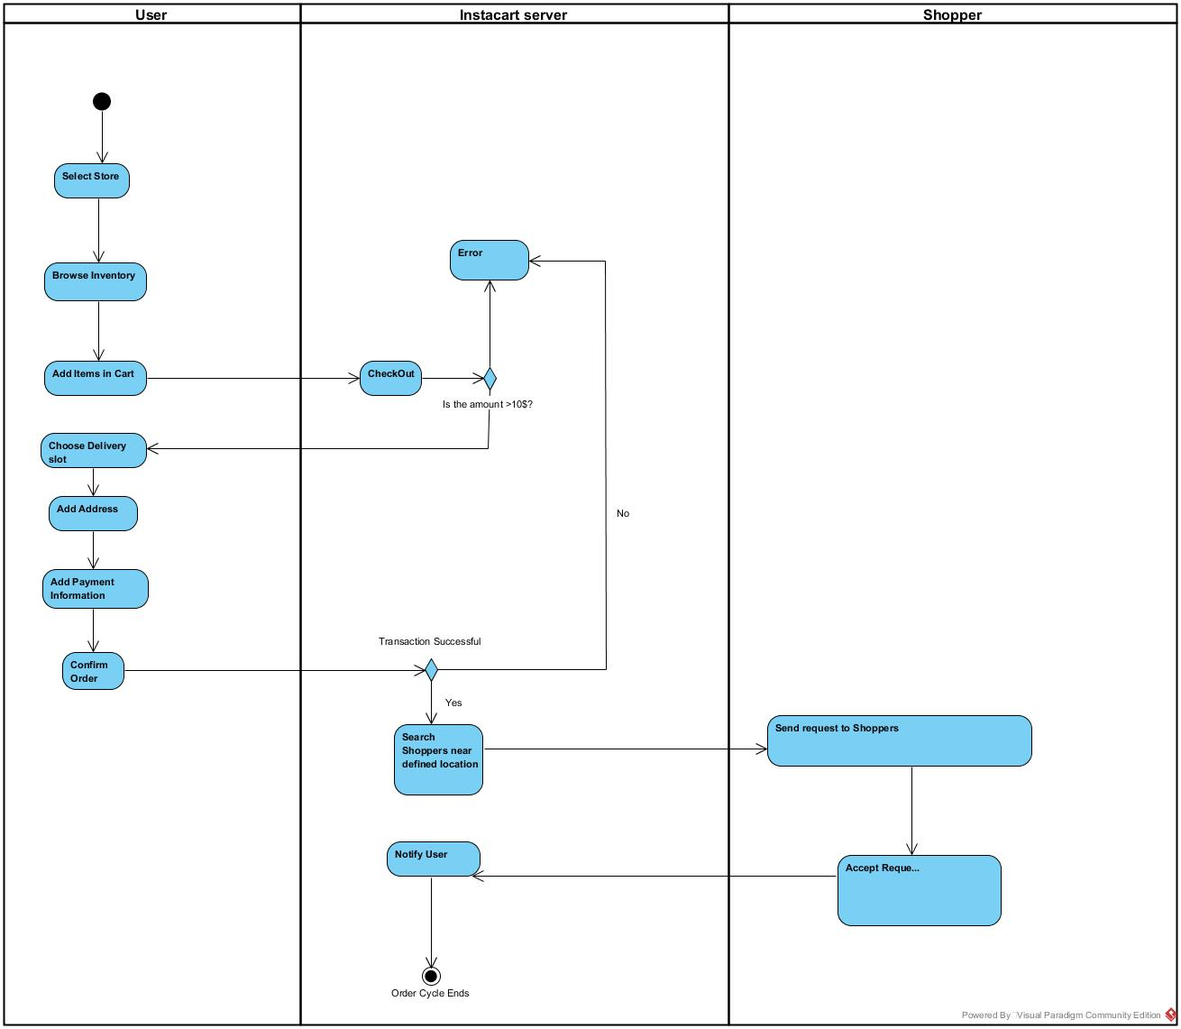
Current System (UML)

Slide 13
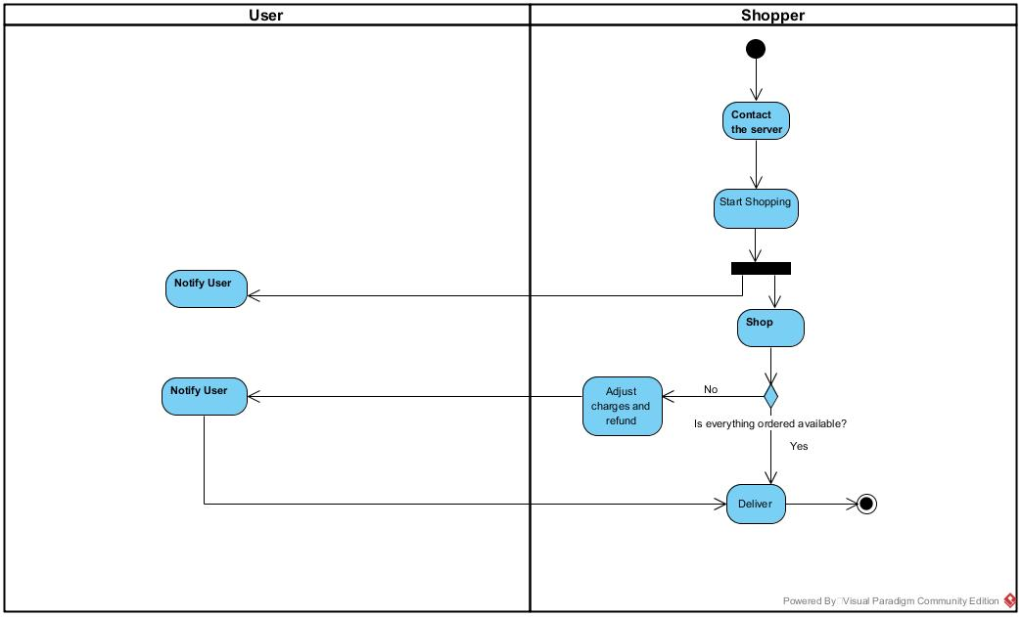

Slide 14
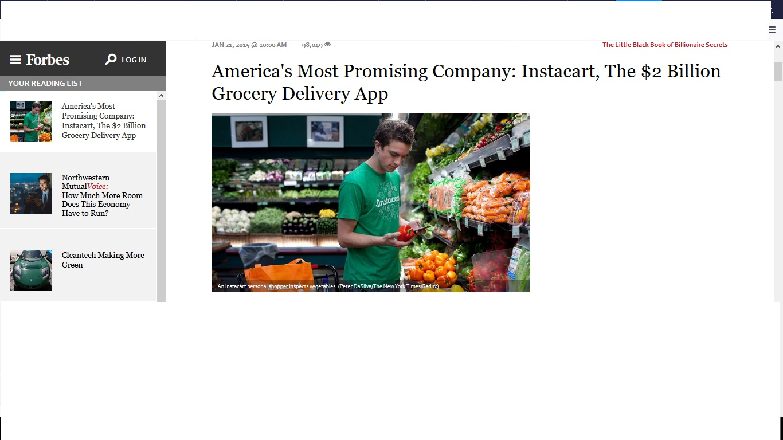
Instacart Success

Slide 15
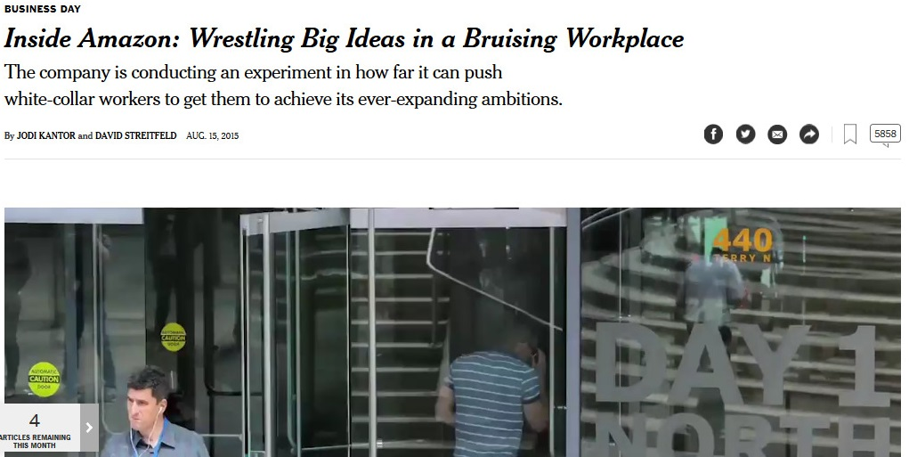
Our Motivation

Slide 16


Survey Link
https://www.surveymonkey.com/r/TWZJZ78

Slide 17


Customer Reviews

Slide 18
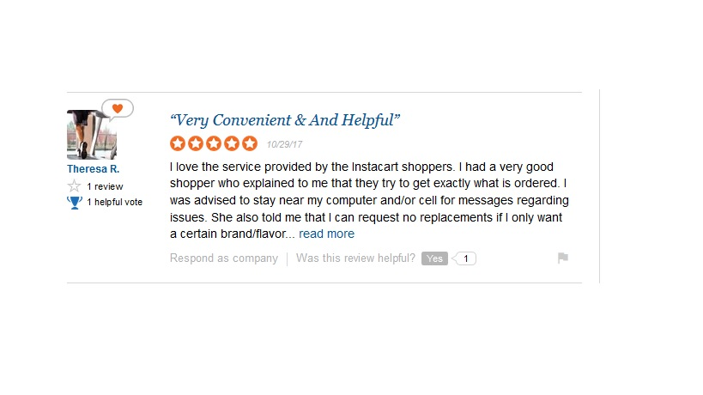
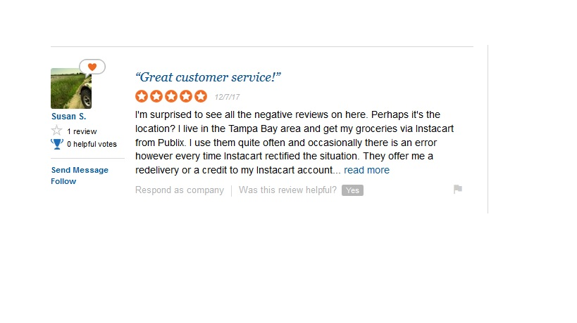
The Good

Slide 19
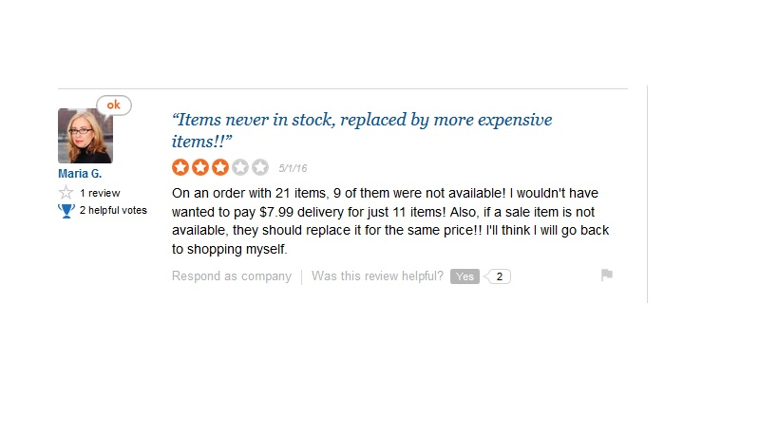
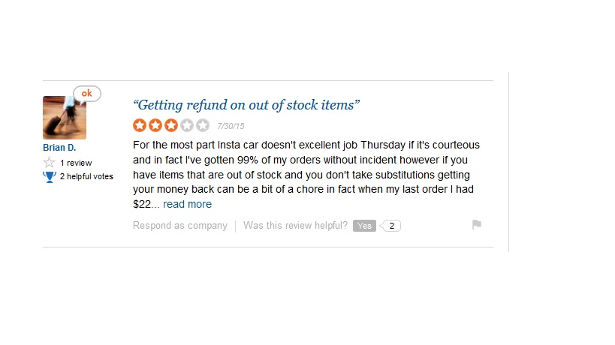
The Bad

Slide 20
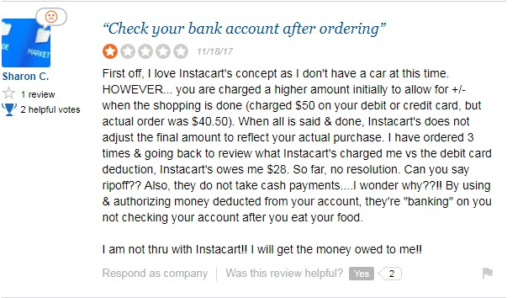
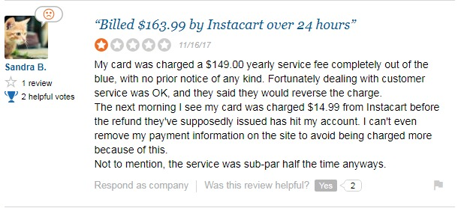
The Ugly

Slide 21
The Instacart Dataset

Slide 22

About the Dataset
Open source their data to Kaggle community.
It contain 3 million groceries order from 200,000 Instacart customers.
Data contain 4 to 100 orders of each user.
It also contain product ,department and aisles data.
The data also provide the week and the day the order was placed,
It also provide relative measure of time between orders.

Slide 23
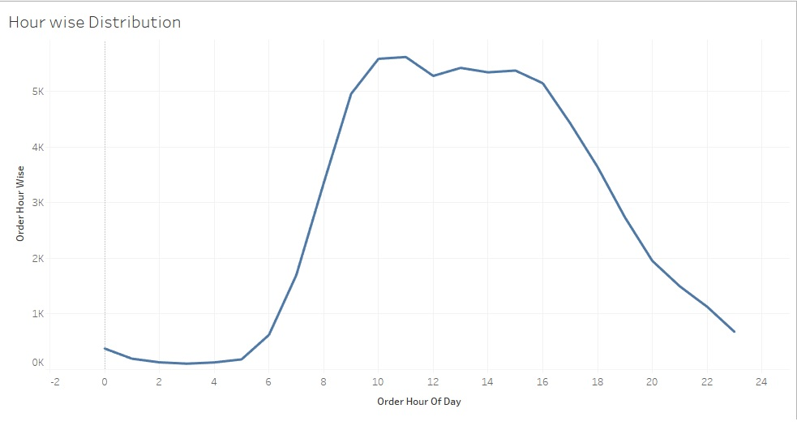

Number of orders peak from 9 AM-4PM

Slide 24
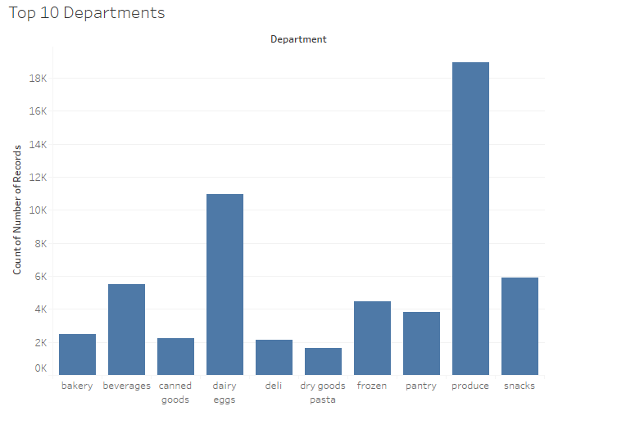
Produce and dairy are the most ordered departments

Slide 25
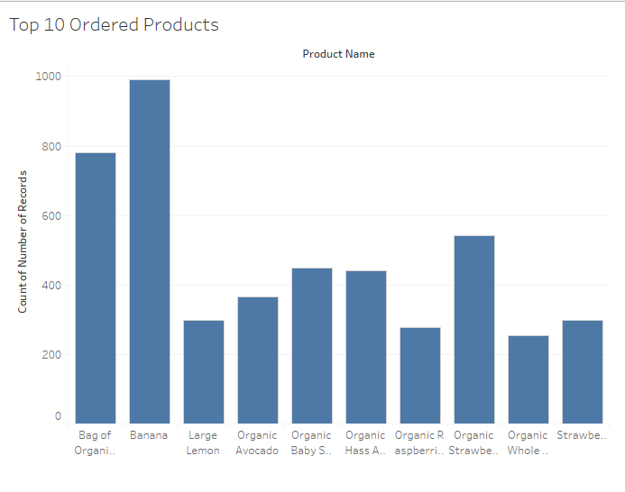
Banana and bag of organic banana are the most ordered products

Slide 26
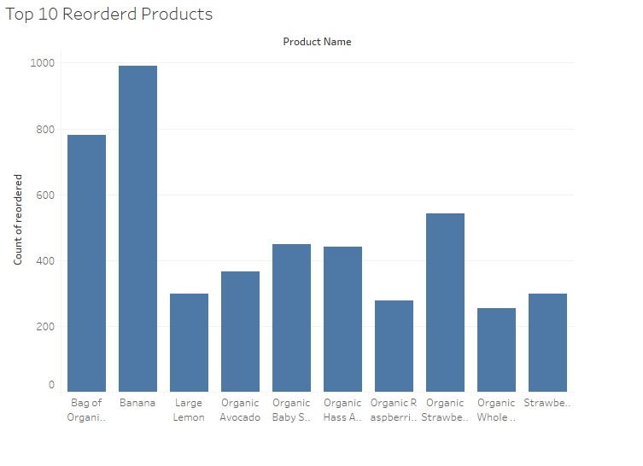
Banana and bag of organic banana are the most reordered products

Slide 27
Problems in the Current System

Slide 28

Problems in the Current System
Inadequately trained shoppers
Over hiring
Low wages

Slide 29
Proposed Solutions

Slide 30


Proposed Solutions
Over hiring
Hiring of skilled shoppers
Recognition to shoppers upon achievements
Offer competitive pay and benefits
Reveal career vision
Provide better incentives

Slide 31
Proposed Solutions
Inadequately trained shoppers
Conducting In-house training
Providing manuals
Conducting surveys to enhance training
Aligning training with company objectives
Enabling the employee to establish goals, priorities, and measurements
Peer training by employees
Provide commonly needed training and information on company website
Perform brown bag lunch format by experts

Slide 32
Proposed Solutions
Low wage
Provide incentives to compensate low wage- Coupons, discounts
Differential wages based on achievements
Less hiring

Slide 33
Issues in Proposed Solution

Slide 34

Issues in Proposed Solution
Training would exclude implicit instructions
Incentives in the form of coupons/discounts will not suffice as a motivation to most shoppers
No proper way to determine achievements of a shopper
Paying more towards getting skilled shoppers might still be ineffective in this scenario, as the shoppers work as independent contractors

Slide 35
Strategies for Solution Implementation

Slide 36
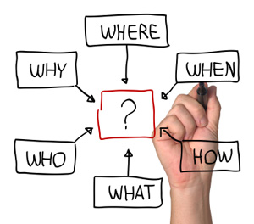
Strategies for Solution Implementation
Guiding Principles
Design a roadmap
Implementing training checkpoints
Governance
Gap Analysis

Slide 37

Questions ??

